Slide 1
DNS Deeper Dive:
Loosely Coherent... and Loosely Defined...
Geoff Huston <gih@apnic.net>
Wes Hardaker <hardaker@isi.edu>
João Damas <joao@apnic.net>

Slide 2
Note Well
This is a reminder of IETF policies in effect on various topics such as patents or code of conduct. It is only meant to point you in the right direction. Exceptions may apply. The IETF's patent policy and the definition of an IETF "contribution" and "participation" are set forth in BCP 79; please read it carefully.
As a reminder:
By participating in the IETF, you agree to follow IETF processes and policies.
If you are aware that any IETF contribution is covered by patents or patent applications that are owned or controlled by you or your sponsor, you must disclose that fact, or not participate in the discussion.
As a participant in or attendee to any IETF activity you acknowledge that written, audio, video, and photographic records of meetings may be made public.
Personal information that you provide to IETF will be handled in accordance with the IETF Privacy Statement.
As a participant or attendee, you agree to work respectfully with other participants; please contact the ombudsteam (https://www.ietf.org/contact/ombudsteam/) if you have questions or concerns about this.
Definitive information is in the documents listed below and other IETF BCPs. For advice, please talk to WG chairs or ADs:
BCP 9 (Internet Standards Process)
BCP 25 (Working Group processes)
BCP 25 (Anti-Harassment Procedures)
BCP 54 (Code of Conduct)
BCP 78 (Copyright)
BCP 79 (Patents, Participation)
https://www.ietf.org/privacy-policy/ (Privacy Policy)

Slide 3
What’s in a Name?
In a network that uses destination-based packet forwarding, a “name” is a human-use alias for an endpoint destination
  An endpoint destination is an IP address used by the network to relay a packet onto its intended destination
  Multiple services on a host are implicitly disambiguated by using Transport Protocol Port addresses – the name itself is the name of the platform, not the name of a particular service
  Names were useful to the client (not necessarily to the host named by the client)

Slide 4
What’s in a Name?
Human-use names were intended to be constant across protocol families for a single host
  Host Name conventions became a Lowest Common Denominator issue of matching various protocol-specific and application-specific limitations
  Hence the subtle distinctions between host name and DNS labels
    Which João will explore in detail later on…

Slide 5
DNS Resource Records
Original name model was based on HOSTS.TXT model
  Simple Name to IP address mapping
  Match the name to 1 or more entries in the file
  Return one of more IP addresses listed in these matched entries
  The “resource” here is the IP address in the hosts file
This is a client-centric name alias model
  Different hosts could use different HOSTS.TXT files without fundamental damage
The DNS shifted this replicated file into a distributed database
  This created a publisher-centric model of names and resources
A structured name space and a distributed database created a requirement for additional “meta” records
  SOA records to control common zone behaviours
  NS records to control navigation through the distributed database to resolve names

Slide 6
Service Names
Then we added service names to host names
  It became common practice to use a label prefix to denote the service:
    www.example.com for port 80 HTTP service
    ftp.example.com for port 21 ftp service
This enabled a set of hosts to be used to support the set of services located behind a common host name in a manner that was specific to the service, not the host
It was a small step to then include the service name into the application-level protocol exchange so that a named host could provide services to multiple named services:
  Secondary MX server records for a named mail destination domain
foo.example.com MX 5 bar.example.com
bar.example.com IN A 192.0.2.0
“Hi 192.0.2.0, I want to send mail to user@foo.example.com”

Slide 7
Service Names
Service Names become an abstraction used by application protocols to allow orchestration of multiple servers to provide a named service to clients
  These points of service delivery may not be visible to users, and need not necessarily be names within a domain of human-friendly use
Some service names are loaded into the DNS itself through resource records
  Such as NS and MX RRs
Others are established through explicit alias records
  CNAME RRs
Others are implicit
  Using the A/AAAA records of the service delivery host against the service name

Slide 8
What’s a Name?
A long-held universally visible stable service point identifier suitable for human use
A transient label used by applications to resolve temporal rendezvous requirements
A bridging point to glue together the DNS database
A fragment of code (query) sent to a code interpreter (server)
Or: All the above and more!

Slide 9
Service Identification
There are now multiple ways in the DNS to associate a service provider with a service
Each DNS rendezvous mechanism we invent proposes a generic mechanism that can be used by any application
But each application appears to use a unique specific DNS solution!
  Place information in the value part of the key/value store
  Map the query name to a different query name
  Modify the Query Type to have application specific data

Slide 10
TXT Records
The universal DNS “one size fits all” DNS resource record
  Treats the DNS as a key-value store
  TXT records can be internally structured according to the requirements of the application
  Of course if the same name is used for multiple services the overloading of the TXT record can become a problem

Slide 11
SPF Records
Sender Policy Framework for Mail
  Validation of service identity as an authorized agent for the application level service identity
Implemented as a TXT record with internal structure
  See previous comment on overloading of TXT record!
Can use more domain names on the RHS as an include: directive
  Which allows the formation of extended chains and loops
example.com TXT “v=spf1 ip4:34.243.61.237 ip6:2a05:d018:e3:8c00:bb71:dea8:8b83:851e include:thirdpartydomain.com –all”
Potential loop!

Slide 12
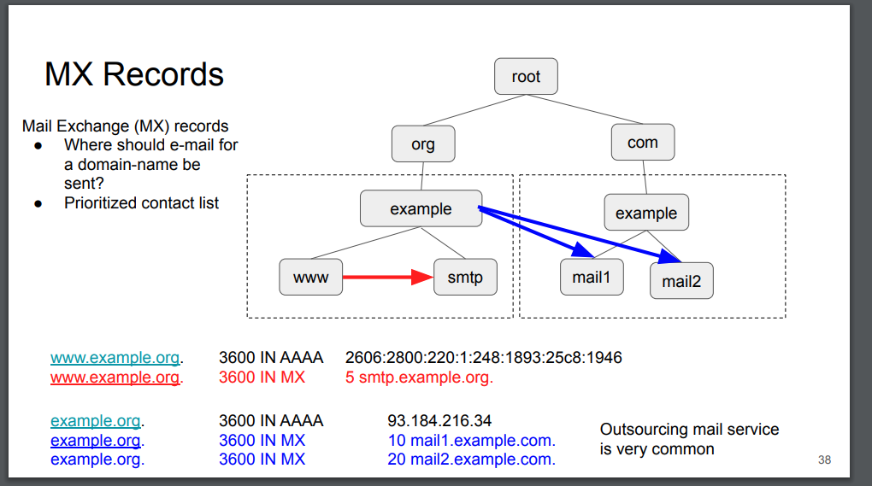
MX Records
Application specific redirection in the name space

Slide 13
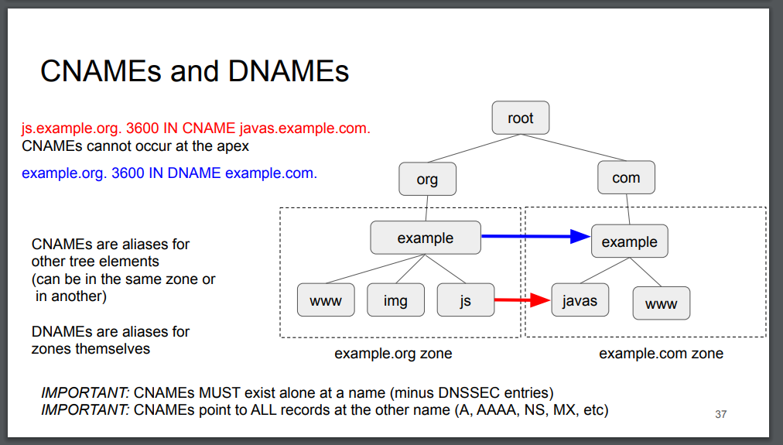
CNAME and DNAME Records
Alias name form to create a generic service redirection through query name mapping as part of the name resolution process
Zones? NO - Subtrees!
Anything below a DNAME is not reachable!
There is NOTHING below a CNAME!

Slide 14
CNAME and DNAME loops
The use of a DNS name in the resource record can form a DNS loop if the name needs to be resolved itself using the same Qtype query
  There are two issues with such loops: cache stuffing of intermediate resolution outcomes and resolver time when following a loop
dog.com CNAME cat.com
cat.com CNAME dog.com
dog.com DNAME cat.com
cat.com DNAME dog.com
dog.com CNAME cat.com
cat.com DNAME dog.com

Slide 15
NAPTR
What happens if we take a TXT value and interpret it as a regular expression to apply to the query name, and add additional fields to specify order and preference among multiple such NAPTR records for a single label?
  Then we get a NAPTR record!
$ORIGIN 2.1.2.1.5.5.5.0.7.7.1.e164.arpa.
IN NAPTR 100 10 "u" "sip+E2U" "!^.*$!sip:information@tele2.se!" .
IN NAPTR 102 10 "u" "mailto+E2U" "!^.*$!mailto:information@tele2.se!" .

Slide 16
Black Holes and Loops
Resolver Forwarder loops
  A set of forwarder clauses in resolver configurations may cause queries to loop across the resolvers in the loop
DNS Data loops and holes
  NS
    Normally a parent zone NS record will contain glue records for the IP address of the listed name server
    If not then the resolver has to pause the primary resolution task and resolve the name of the name server
      Black holes: NS<x>.example.com IN NS NS<x+1>.example.com
      Loops: ns.dog.com IN NS ns.cat.com
      ns.cat.com IN NS ns.dog.com
      This will consume resolver and server resources if not handled sensibly
  CNAME, DNAME and NAPTR loops
    Any DNS structure that includes a name that needs to be applied recursively into the DNS has the potential to create loops

Slide 17
SRV
Generic form of MX record
Identifies the service by name and the transport protocol / port address
SRV maps the service name to one or more service hosts through the use of service prefix labels to the DNS service name
The RHS host name is the canonical name
_sip._tcp.example.com. 3600 IN SRV 10 60 5060 sipserver.example.com.
_sip._tcp.example.com. 3600 IN SRV 10 20 5060 someone.elses.sip.server.org.

Slide 18
SVCB
When SRV is not enough
  ALTSVC, ANAME, ESNIKEYS, etc all assembled into a single DNS entry
An “Alias Form” where operational control of a resource is designated elsewhere
A “Service Form” to define the parameters of the operational service
_8443._foo.api.example.com. IN SVCB 0 svc4.example.net.
svc4.example.net. IN SVCB 3 ( svc4.example.net. alpn="bar" port="8004" esnikeys="..." )
foo://api.example.com:8443” is aliased to use ALPN protocol “bar” service endpoints offered at “svc4.example.net” on port 8004.

Slide 19
HTTPSSVC
SVCB for the HTTPS scheme
Equivalent of the HTTP Alt-Svc response header – shifted into the DNS
Alt-Svc: h3="svc.example.net:8003"; ma=3600; foo=123, h2="svc.example.net:8002"; ma=3600; foo=123
www.example.com. 3600 IN HTTPSSVC 2 svc.example.net. ( alpn=h3 port=8003 foo=123 )
HTTPSSVC 3 svc.example.net. ( alpn=h2 port=8002 foo=123 )

Slide 20
DNS and Information Leakage
Historically, the DNS is not the most secure of protocols
  And while effort is underway to improve this situation in some ways, the DNS is still extremely chatty – promiscuously so!
To what extent do these service records exacerbate these issues by ”informing” the DNS of the end user’s immediate intentions of subsequent service-level activity?
Do we need to undertake more analysis of the issue of the trade offs between adding additional rendezvous attributes to the DNS and the extent to which the DNS leaks even more information as to a user’s immediate intentions to an eavesdropper?

Slide 21
And now…
Over to Wes…

