Slide 1
Measuring KSK Roll Readiness
Geoff Huston
APNIC Labs

Slide 2
The DNS may look simple

Slide 3
For the DNS looks are very deceiving

Slide 4
What we would like the DNS to be
Client
DNS Resolver
DNS Server

Slide 5
What we suspect is more like theDNS
Client
DNS Resolver
DNS Server
DNS Resolver
DNS Resolver
DNS Resolver
DNS Resolver
DNS Resolver
DNS Resolver
DNS Resolver
DNS Resolver
DNS Resolver
DNS Resolver
DNS Resolver
DNS Resolver

Slide 6
Signalling via Queries
Client
DNS Resolver
Server
Queries
DNS Resolver
DNS Resolver
DNS Resolver
DNS Resolver
The query contains information which passes inward in the DNS towards the authoritative server(s)
DNS Resolver
DNS Resolver
DNS Resolver
DNS Resolver
DNS Resolver
DNS Resolver
DNS Resolver
DNS Resolver

Slide 7
Signalling via Responses
Client
DNS Resolver
Server
Responses
DNS Resolver
DNS Resolver
DNS Resolver
DNS Resolver
The response contains information which passes backward in the DNS towards the original querier
DNS Resolver
DNS Resolver
DNS Resolver
DNS Resolver
DNS Resolver
DNS Resolver
DNS Resolver
DNS Resolver

Slide 8
KSK Roll Measurement Objective
What number of users are at risk of being impacted by the KSK Roll?
  There are two risk elements for resolvers:
    Unable to receive a 1,414 octet UDP response from the root servers (query for DNSKEY RR from the root zone)
    Failure to follow RFC5011 key introduction procedure
  In either case the resolver outcome is the same: Not loading the incoming trust key into the local trusted key store
  And if the user passes queries only to these affected resolvers than the roll will cause a loss of DNS service

Slide 9
Measuring Resolvers via RFC8145 Signaling
Getting resolvers to report on their local trusted key state
  Resolvers that support the RFC 8145 signal mechanism periodically include the key tag of their locally trusted keys into a query directed towards the root servers

Slide 10
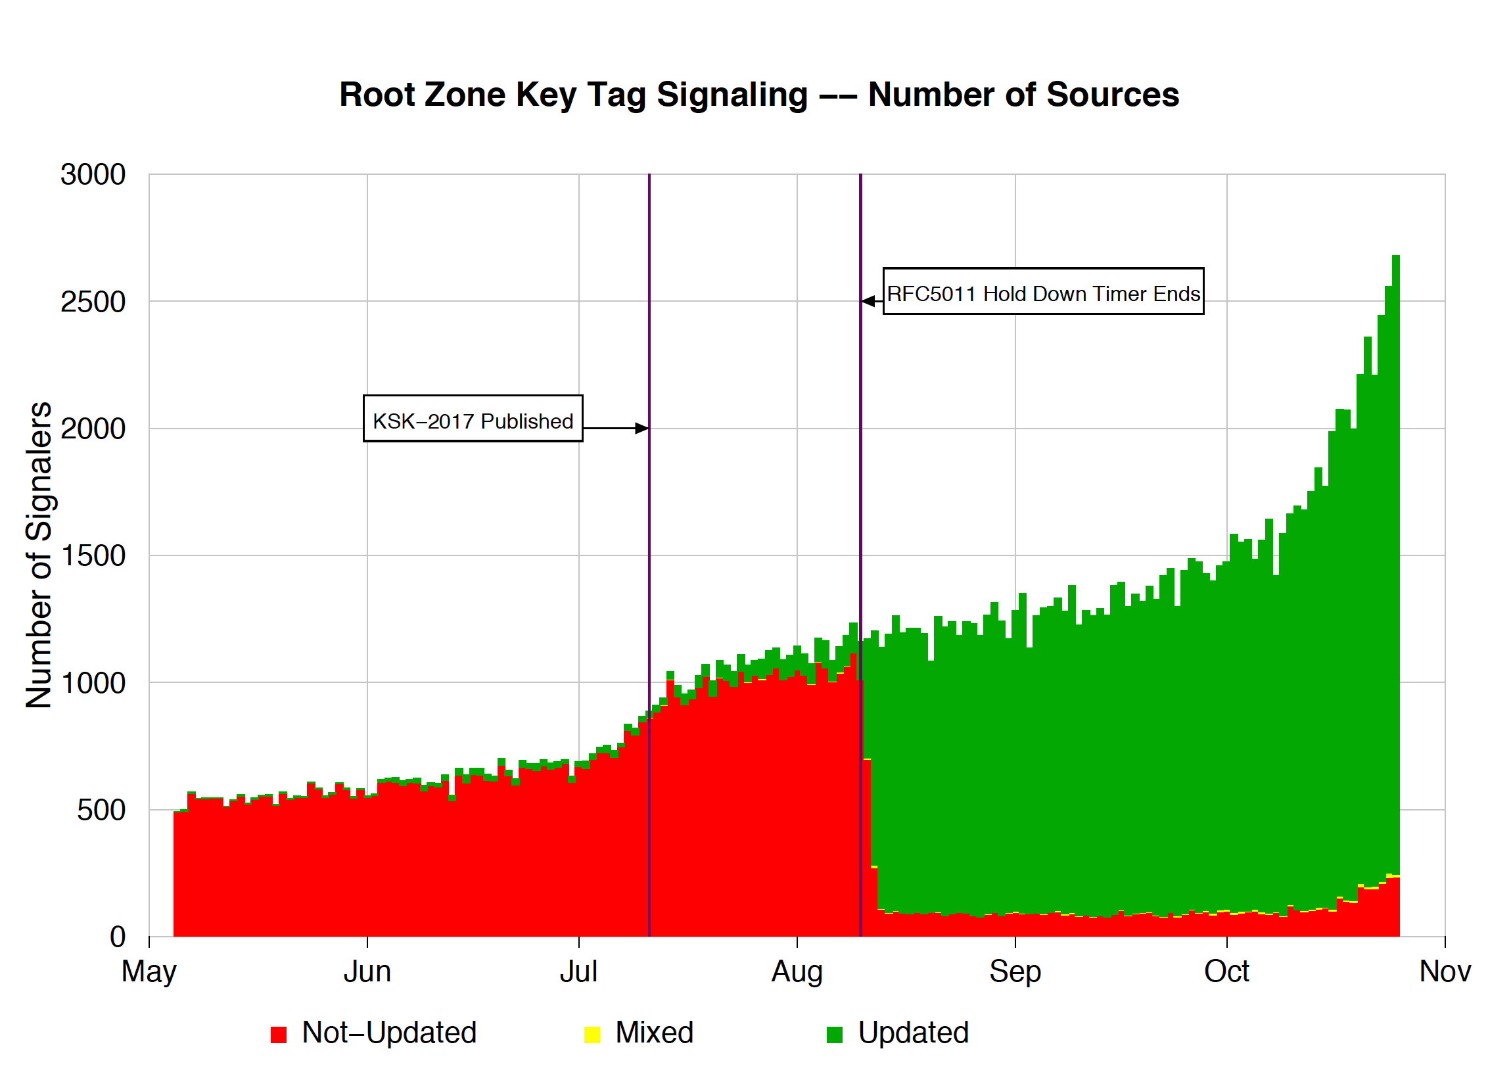
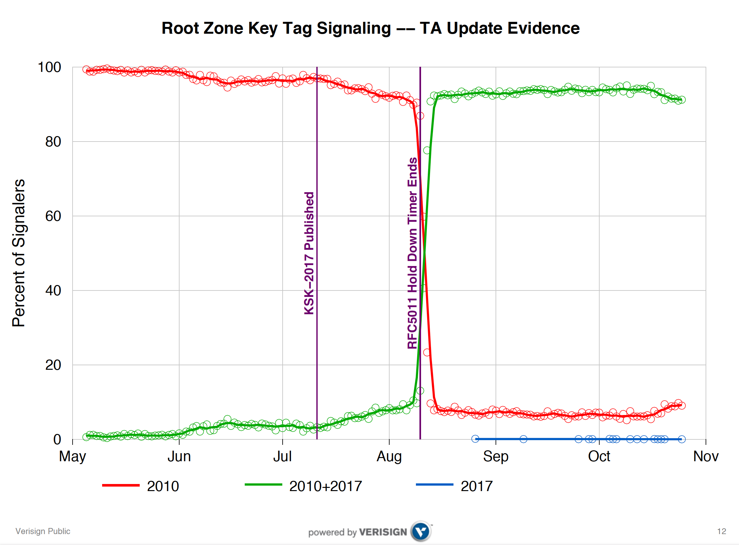
What did we see at (some) roots?
Duane Wessels VeriSign RFC 8145 Signaling Trust Anchor Knowledge In DNS Security Extensions
Presentation to DNSSEC Workshop @ ICANN 60 – 1 Nov 2017
https://schd.ws/hosted_files/icann60abudhabi2017/ea/Duane%20Wessels-VeriSign-RFC%208145-Signaling%20Trust%20Anchor%20Knowledge%20in%20DNS%20Security%20Extensions.pdf

Slide 11
What is this saying?
Its clear that there is some residual set of resolvers that are signalling that they have not yet learned to trust the new KSK key
But its not clear if:
  This is an accurate signal about the state of this resolver
  This is an accurate signal about the identity of this resolver
  How many users sit ‘behind’ this resolver
  Whether these uses rely solely on this resolver, or if they also have alternate resolvers that they can use
  What proportion of all users are affected

Slide 12
Why?
Because the DNS does not disclose the antecedents of a query
  If A forwards a query to B, who queries a Root Server then if the query contains an implicit signal (as in this case) then it appears that B is querying, not A
  At no time is the user made visible in the referred query
Because caching
  If A and B both forward their queries via C, then it may be that one or both of these queries may be answered from C’s cache
  In this case the signal is being suppressed
Because its actually measuring a cause, not the outcome
  Its measuring resolvers’ uptake of the new KSK, but is not able to measure the user impact of this

Slide 13
User-Side Measurement
Can we devise a DNS query that could reveal the state of the trusted keys of the resolvers back to the user?
  Not within the current parameters of DNSSEC and/or resolver behaviour

Slide 14
User-Side Measurement
Can we devise a DNS query that could reveal the state of the trusted keys of the resolvers back to the user?
  What if we could change resolver behaviour?
    Just as RFC8145 required a change in resolver behaviour
  What about a change to the resolver’s reporting of validation outcome depending on the resolver’s local trusted key state?
    If a query contains the label “_is-ta-<key-tag>” then a validating resolver will report validation failure if the key is NOT in the local trusted key store
    If a query contains the label “_not-ta-<key-tag>” then a validating resolver will report validation failure if the key IS in the local trusted key store

Slide 15
User-Side Resolver Measurement
Three DNS queries:
  _is-ta-4066.<some.signed.domain>
  _not-ta-4066.<some.signed.domain>
  <badly-signed>.<some.signed.domain>
Single Resolver Analysis:
Resolver Behaviour Type
Loaded New KSK
NOT loaded New KSK
Mechanism not supported
Not validating
Query 1 Query 2 Query 3
A SERVFAIL SERVFAIL
SERVFAIL A SERVFAIL
A A SERVFAIL
A A A

Slide 16
User-Side DNS Measurement
Multiple Resolver Analysis
  A SERVFAIL response will cause the use to repeat they query to other configured resolvers. In a multi-resolver scenario, and where forwarders are used we can still determine if the user will be impacted by the KSK roll
User Impact
OK
NOT OK
Query 1 Query 2 Query 3
A SERVFAIL SERVFAIL
SERVFAIL A SERVFAIL
A A SERVFAIL
SERVFAIL SERVFAIL SERVFAIL
A A A
UNKNOWN
NOT Impacted

Slide 17
Measuring User Impact
Create these tests in a scripted web page and allow users to test the state of their resolvers
Load these tests into an online ad campaign and use the ad to pass the test to millions of users
  If the user can resolve Query 1, and SERVFAILs on Query 2 and Query 3 then the user is able to validate using the nominated key as a trusted key
  If the user SERVFAILS on Query 1, resolves Query 2 and SERVFAILs on Query 3 then the user is unable to validate using the nominated key as a trusted keys
  Otherwise if the user SERVFAILS on Query 3 then the result is indeterminate

Slide 18
Privacy and Security Considerations
This test itself does not reveal which resolvers are used by end users in resolving names
The query itself need not contain any end user identifying material
The methodology never changes “insecure” to ”authenticated” – it will only change “authenticated” to “insecure” depending on the resolver’s local trusted key state when resolving certain labels
Anyone can set up a test condition within their delegated part of the DNS
The results of the test are passed back only to the user in the form of a resolution outcome

Slide 19
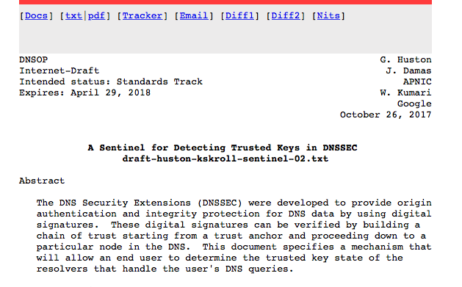
A Description of the Mechanism
draft-huston-kskroll-sentinel

Slide 20
Thanks!

